Slide 1
Pengolahan Citra - Pertemuan III – Image Enhancement
Nana Ramadijanti
Politeknik Elektronika Negeri Surabaya

Slide 2
Materi:
Pemrosesan Piksel
Histogram Gray Scale
Histogram RGB
Pemrosesan Piksel melalui Mapping Fungsi
Pemrosesan Piksel melalui Look-up Table
Brightness
Contrass
Gamma
Histogram Equalisasi
Histogram Matching

Slide 3
Operasi Piksel/ Transformasi Intensitas
Ide dasar :
Operasi “Zero memory”
Setiap output bergantung pada
intensitas input pada piksel yg ada
Memetakan warna level gray atau
warna level u ke level baru v,
misal: v = f ( u )
Tidak memberikan informasi baru
Tapi dapat meningkatkan penampilan visual atau membuat fitur mudah untuk dideteksi
Contoh-1: Transformasi Warna Koordinat
RGB setiap piksel⇨ komponen luminance + chrominance ⇨ dll
Contoh-2: Kuantisasi scalar
Kuantisasi piksel luminance/color dengan jumlah bit yg lebih sedikit
v
output gray level
input gray level u

Slide 4
Pemrosesan Piksel
Pemrosesan piksel adalah mengubah nilai piksel sebagai fungsi dari nilainya sendiri;
Pemrosesan piksel tidak bergantung pada nilai piksel tetangganya.

Slide 5
Pemrosesan Piksel pada Citra
Brightness dan contrast adjustment
Gamma correction
Histogram equalization
Histogram matching
Color correction.

Slide 6
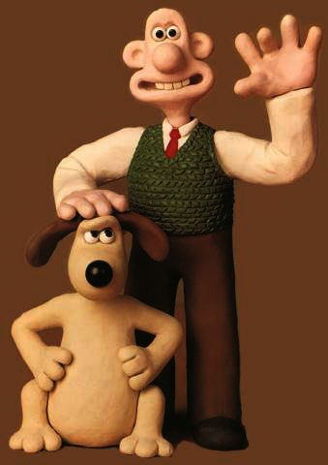
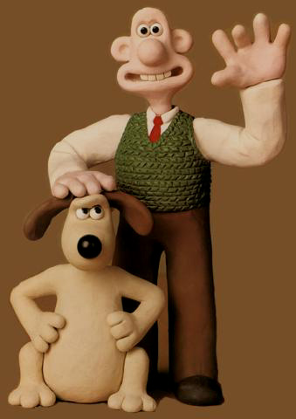
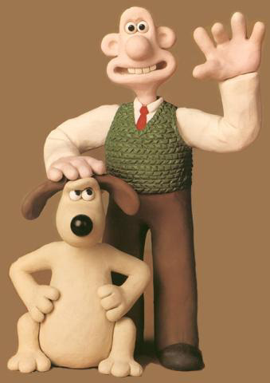
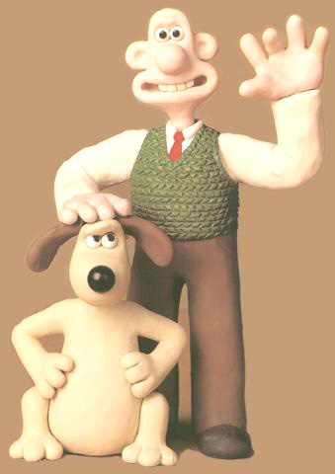
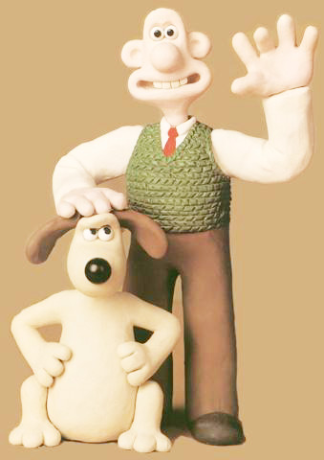
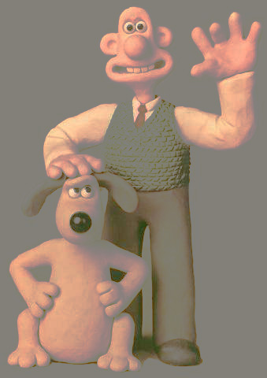
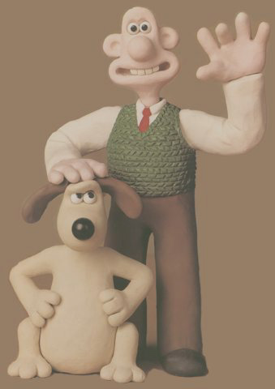
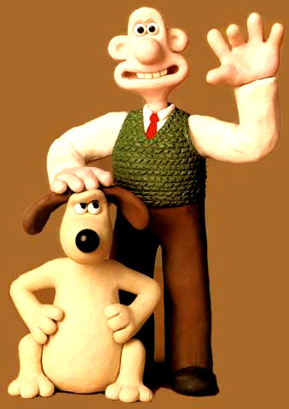
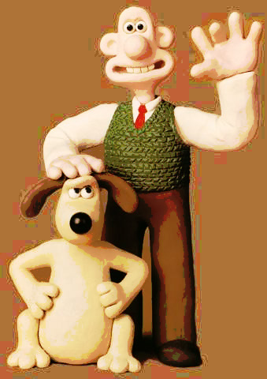
Point Processing
- gamma
- brightness
original
+ brightness
+ gamma
histogram mod
- contrast
original
+ contrast
histogram EQ

Slide 7
Histogram Citra Gray Scale
I adalah citra grayscale.
I(r,c) adalah 8-bit integer diantara 0 dan 255.
Histogram, h_{I}, dari I:
256-element array, h_{I}
h_{I} (g), untuk g = 0, 1, 2, …, 255, adalah integer
h_{I} (g) = jumlah piksel pada I dengan nilai = g.

Slide 8
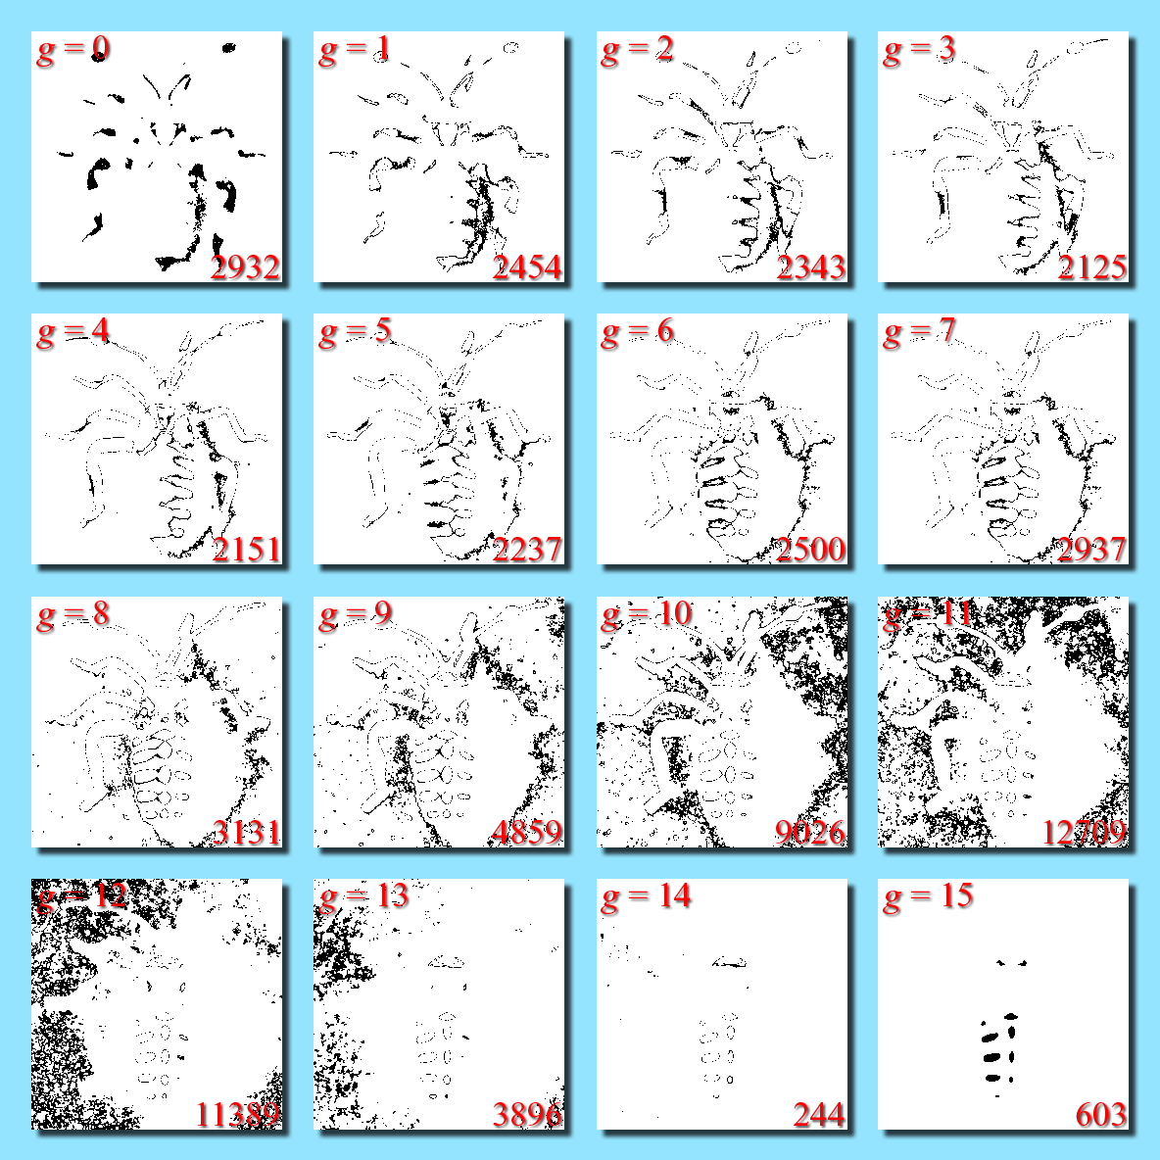
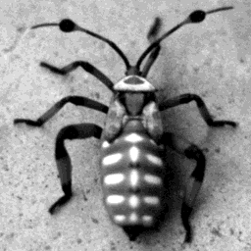
Histogram Citra Gray Scale
16-level (4-bit) citra
Tanda hitam menunjukkan piksel dengan intensitas g

Slide 9
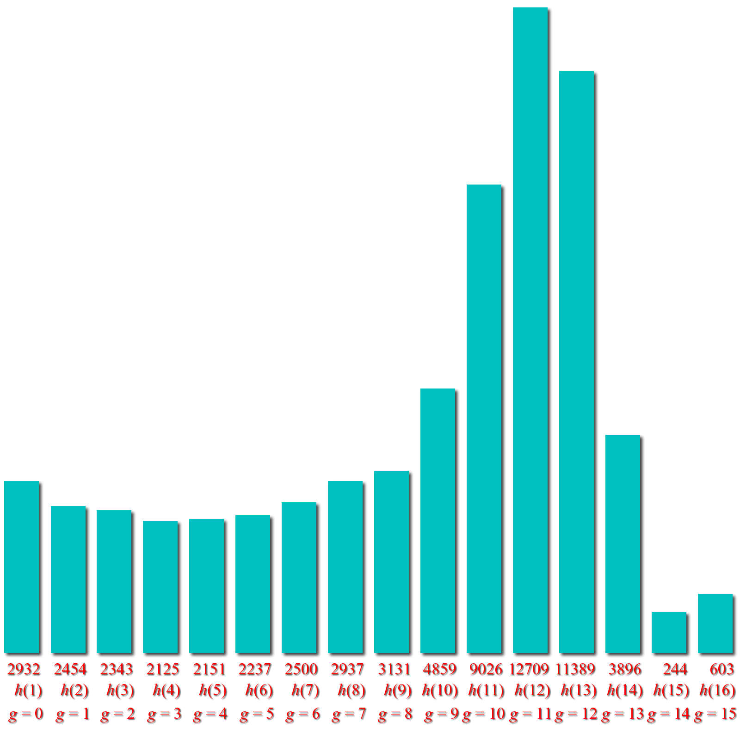
The Histogram of a Grayscale Image
Piksel tanda hitam dengan intensitas g
Histogram :
Jumlah piksel dengan intensitas g

Slide 10
The Histogram of a Grayscale Image
Piksel dengan tanda hitam with intensity g
Plot of histogram:
Jumlah piksel dengan intensitas g

Slide 11
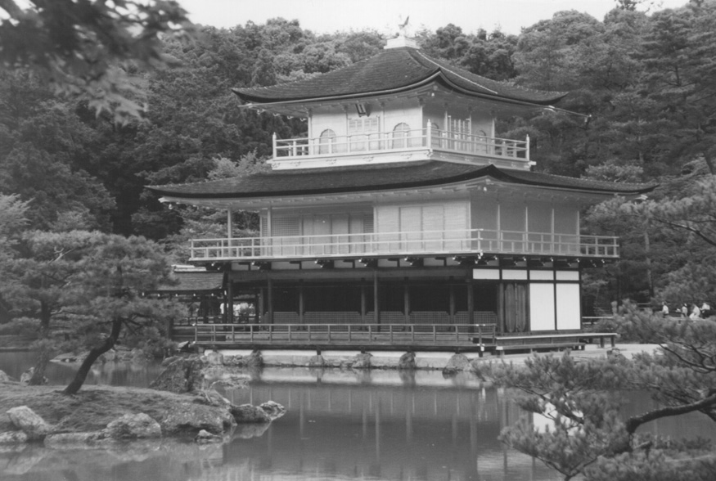
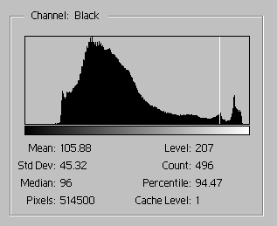
The Histogram of a Grayscale Image
Luminosity

Slide 12
The Histogram of a Color Image
If I is a 3-band image (truecolor, 24-bit)
then I(r,c,b) is an integer between 0 and 255.
Either I has 3 histograms:
h_{R}(g+1) = # of pixels in I(:,:,1) with intensity value g
h_{G}(g+1) = # of pixels in I(:,:,2) with intensity value g
h_{B}(g+1) = # of pixels in I(:,:,3) with intensity value g
or 1 vector-valued histogram, h(g,1,b) where
h(g+1,1,1) = # of pixels in I with red intensity value g
h(g+1,1,2) = # of pixels in I with green intensity value g
h(g+1,1,3) = # of pixels in I with blue intensity value g

Slide 13
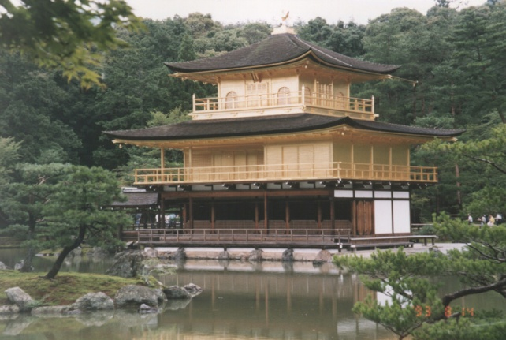
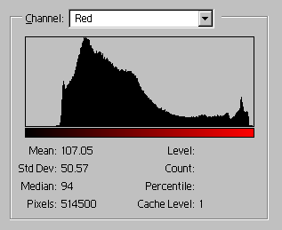
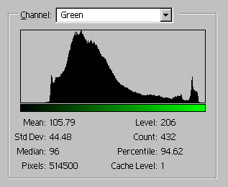
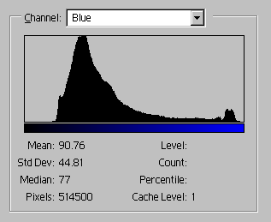
The Histogram of a Color Image
There is one histo-gram per color band
R, G, & B. Luminosity histogram is from 1 band = (R+G+B)/3
Luminosity

Slide 14
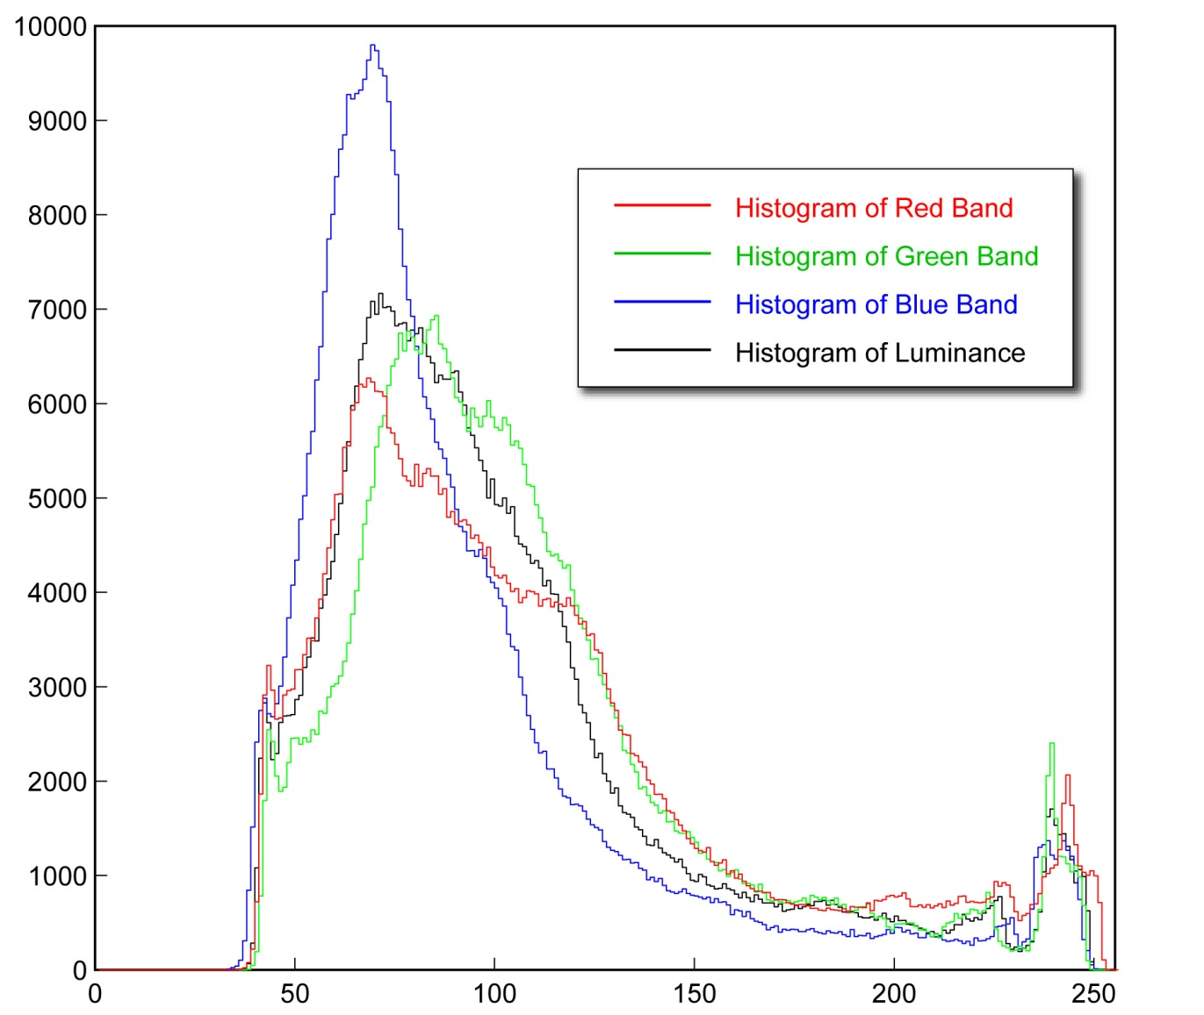
The Histogram of a Color Image

Slide 15
Value or Luminance Histograms
The value histogram of a 3-band (truecolor) image, I, is the histogram of the value image,
Where R, G, and B are the red, green, and blue bands of I.
The luminance histogram of I is the histogram of the luminance image,

Slide 16
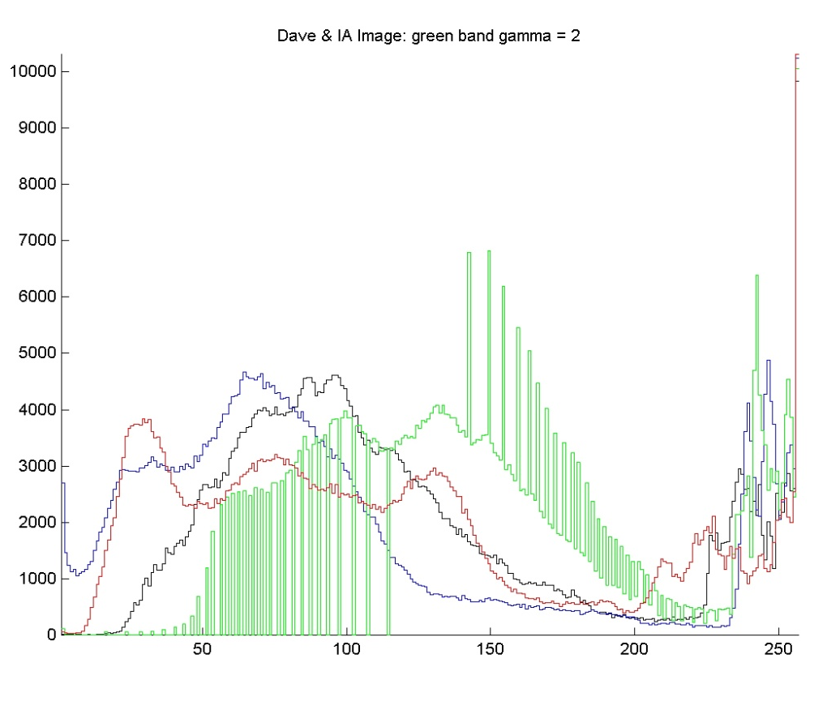
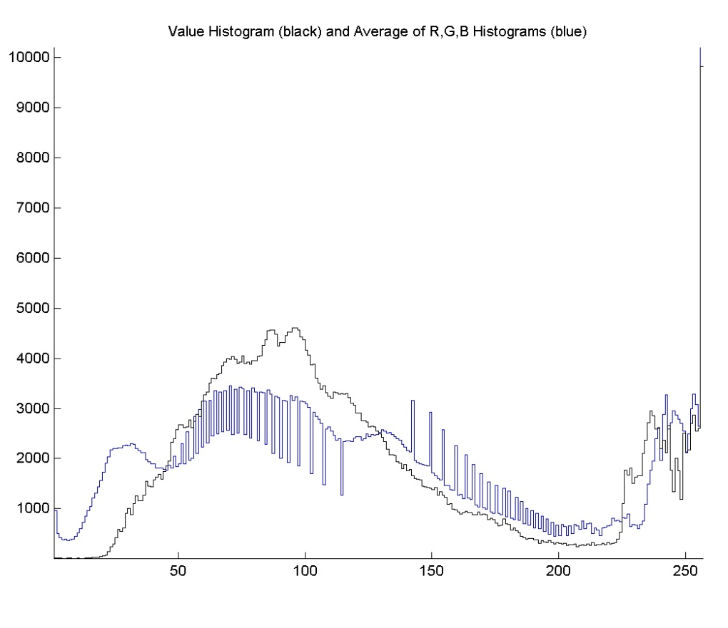
Value Histogram vs. Average of R,G,&B Histograms
R,G,B,&V histograms
V & avg. of R,G,&B histograms

Slide 17
Multi-Band Histogram Calculator in Matlab
% Multi-band histogram calculator
function h=histogram(I)
[R C B]=size(I);
% allocate the histogram
h=zeros(256,1,B);
% range through the intensity values
for g=0:255
h(g+1,1,:) = sum(sum(I==g)); % accumulate
end
return;

Slide 18
Multi-Band Histogram Calculator in Matlab
% Multi-band histogram calculator
function h=histogram(I)
[R C B]=size(I);
% allocate the histogram
h=zeros(256,1,B);
% range through the intensity values
for g=0:255
h(g+1,1,:) = sum(sum(I==g)); % accumulate
end
return;
Loop through all intensity levels (0-255)
Tag the elements that have value g.
The result is an RxCxB logical array that has a 1 wherever I(r,c,b) = g and 0’s everywhere else.
Compute the number of ones in each band of the image for intensity g.
Store that value in the 256x1xB histogram at h(g+1,1,b).
sum(sum(I==g)) computes one number for each band in the image.
If B==3, then h(g+1,1,:) contains 3 numbers: the number of pixels in bands 1, 2, & 3 that have intensity g.

Slide 19
Point Ops via Functional Mappings
Image:
I
Φ, point operator
J
Input
Output
Pixel:
I(r,c)
function, f
J(r,c)
The transformation of image I into image J is accomplished by replacing each input intensity, g, with a specific output intensity, k, at every location (r,c) where I(r,c) = g.
The rule that associates k with g is usually specified with a function, f, so that f (g) = k.

Slide 20
Point Ops via Functional Mappings
One-band Image
Three-band Image

Slide 21
Point Ops via Functional Mappings
One-band Image
Either all 3 bands are mapped through the same function, f, or …
Three-band Image
… each band is mapped through a separate func-tion, f_{b}.

Slide 22
Point Operations using Look-up Tables
… then the LUT that implements f is a 256x1 array
whose (g +1)^{th} value is k = f (g).
A look-up table (LUT) implements a functional mapping.
To remap a 1-band image, I, to J :

Slide 23
Point Operations using Look-up Tables
If I is 3-band, then
each band is mapped separately using the same LUT for each band or
each band is mapped using different LUTs – one for each band.

Slide 24
Point Operations = Look-up Table Ops
255
E.g.:
index
value
...
101
102
103
104
105
106
...
...
64
68
69
70
70
71
...
127
output value
0
0
127
255
input value
input
output

Slide 25
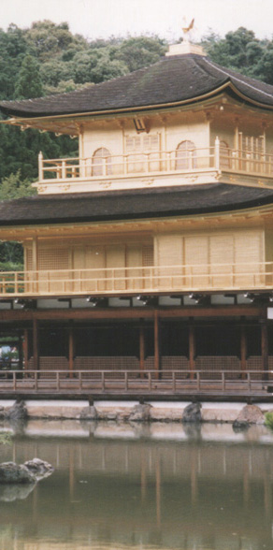
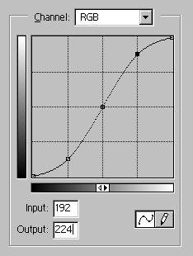
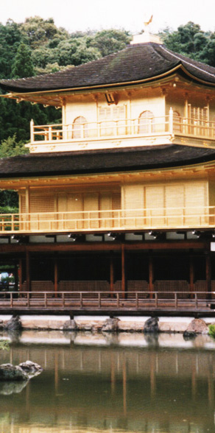
Look-Up Tables
input
output
.
.
.
.
.
.
.
.
a pixel with this value
.
.
is mapped to this value
.
.
cell index
contents
.
.
.
.
.
.
.
.
.
.
.
.

Slide 26
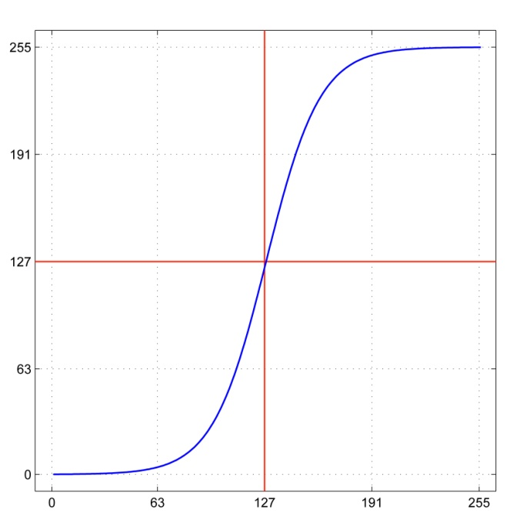
How to Generate a Look-Up Table
For example:
Or in Matlab:
a = 2;
x = 0:255;
LUT = 255 ./ (1+exp(-a*(x-127)/32));
This is just one example.

Slide 27
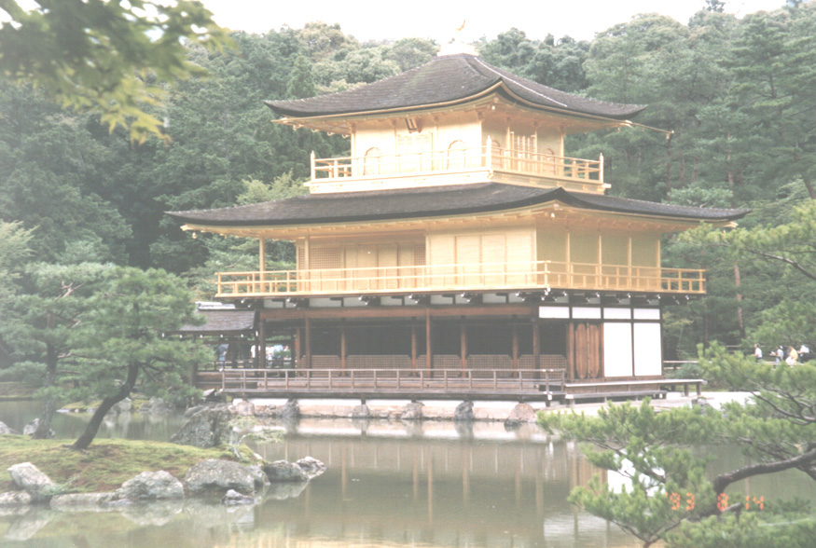
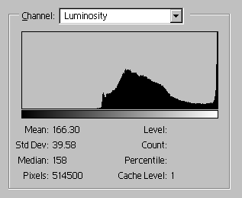
Point Processes: Increase Brightness
255
127
0
0
127
255
transform mapping

Slide 28
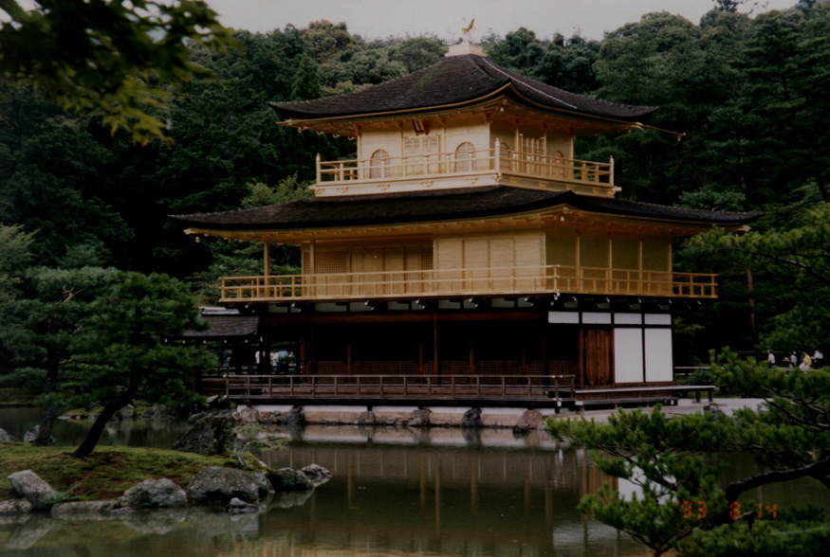
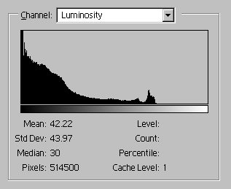
Point Processes: Decrease Brightness
255
255-g
127
0
0
127
255
transform mapping

Slide 29
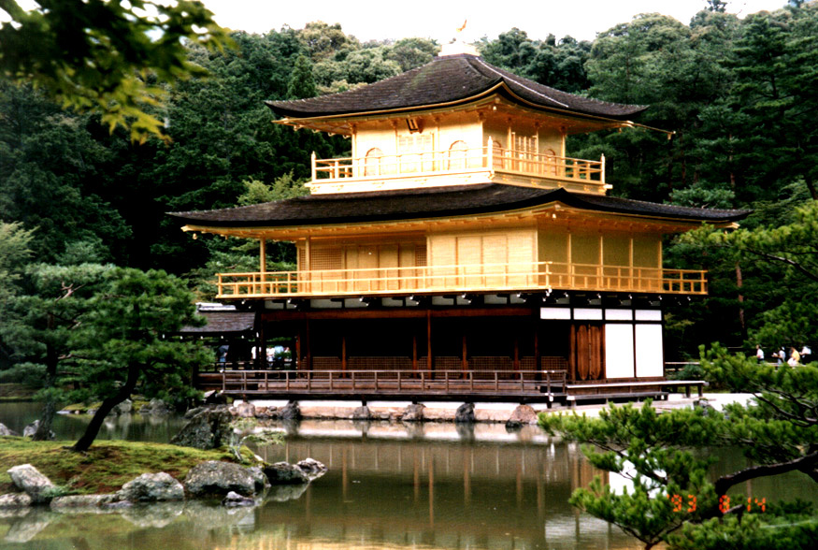
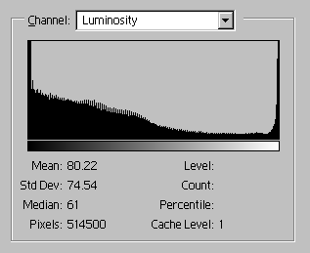
Point Processes: Increase Contrast
255
127
0
0
127
255
transform mapping

Slide 30
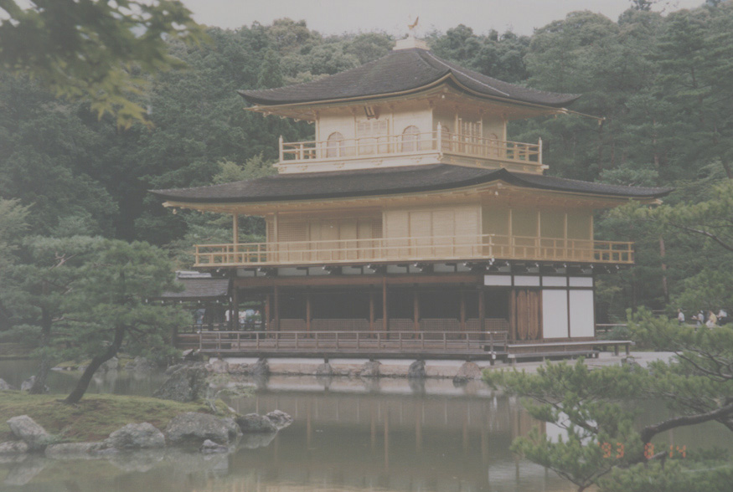
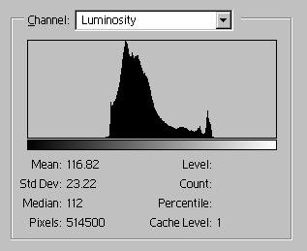
Point Processes: Decrease Contrast
255
127
0
0
127
255
transform mapping

Slide 31
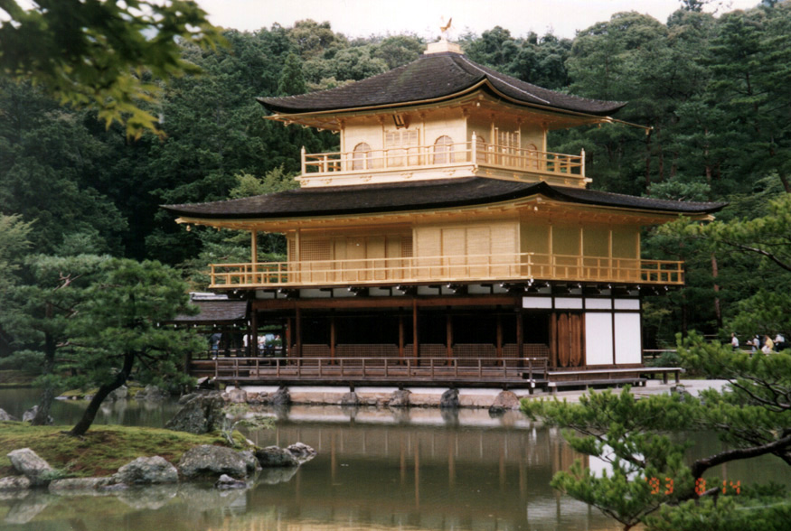
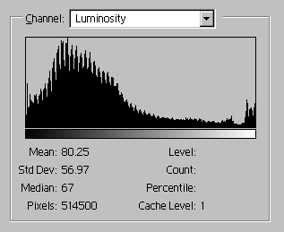
Point Processes: Contrast Stretch
M_{J}
255
127
m_{J}
0
0
m_{I}
127
M_{I}
255
transform mapping

Slide 32
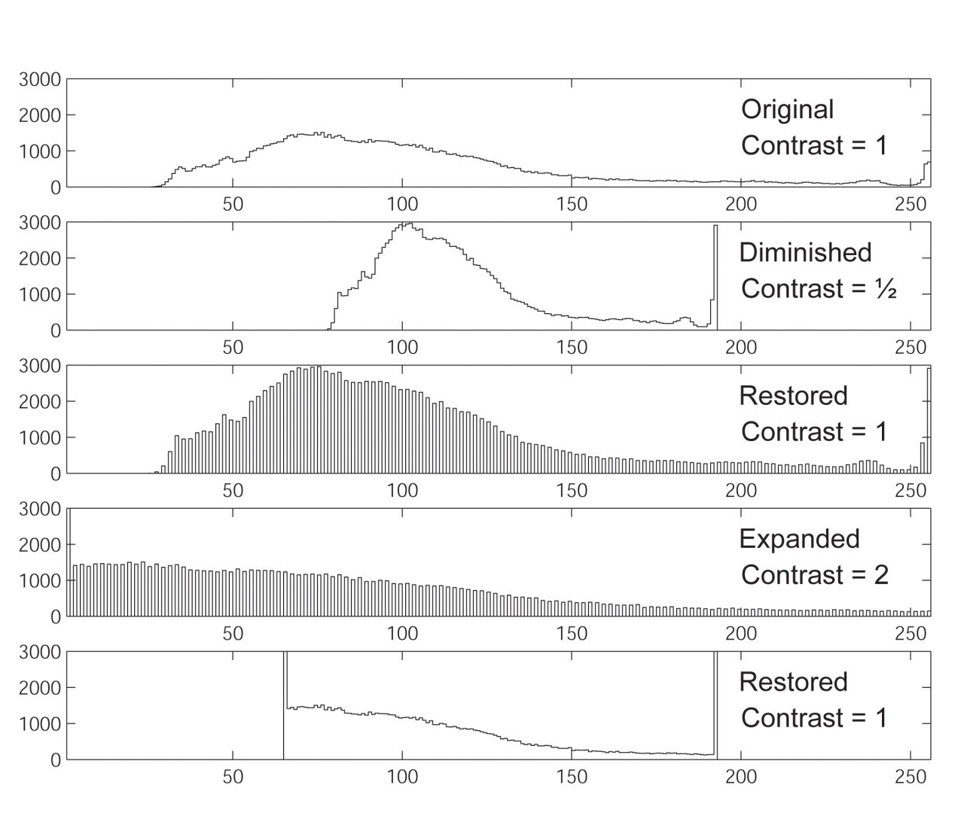
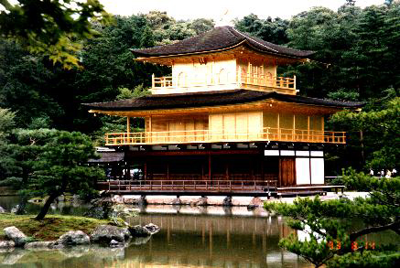
Information Loss from Contrast Adjustment
histograms
orig
lo-c
hi-c

Slide 33
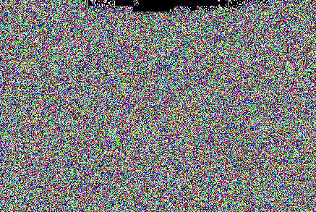
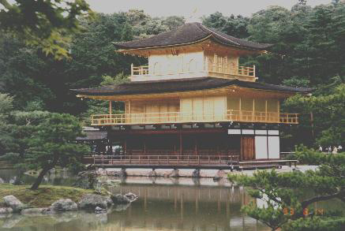
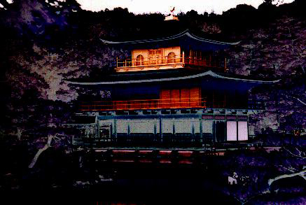
Information Loss from Contrast Adjustment
orig
lo-c
hi-c
abbreviations:
original
low-contrast
high-contrast
restored
difference
orig
lo-c
lo-c
difference between original and restored low-contrast
rest
diff
orig
hi-c
hi-c
difference between original and restored high-contrast
rest
diff

Slide 34
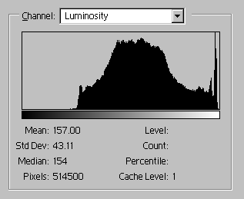
Point Processes: Increased Gamma
255
127
0
0
127
255
transform mapping

Slide 35
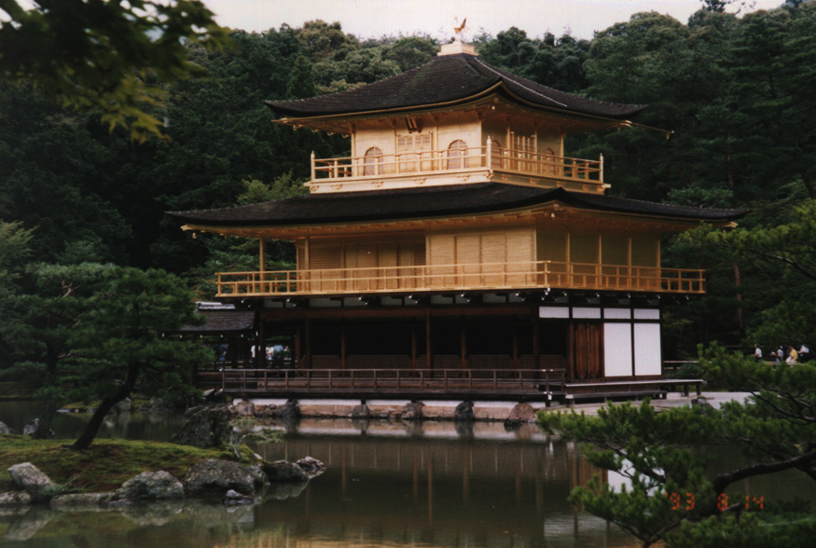
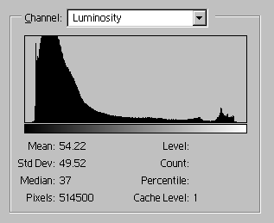
Point Processes: Decreased Gamma
255
127
0
0
m
127
M
255
transform mapping

Slide 36
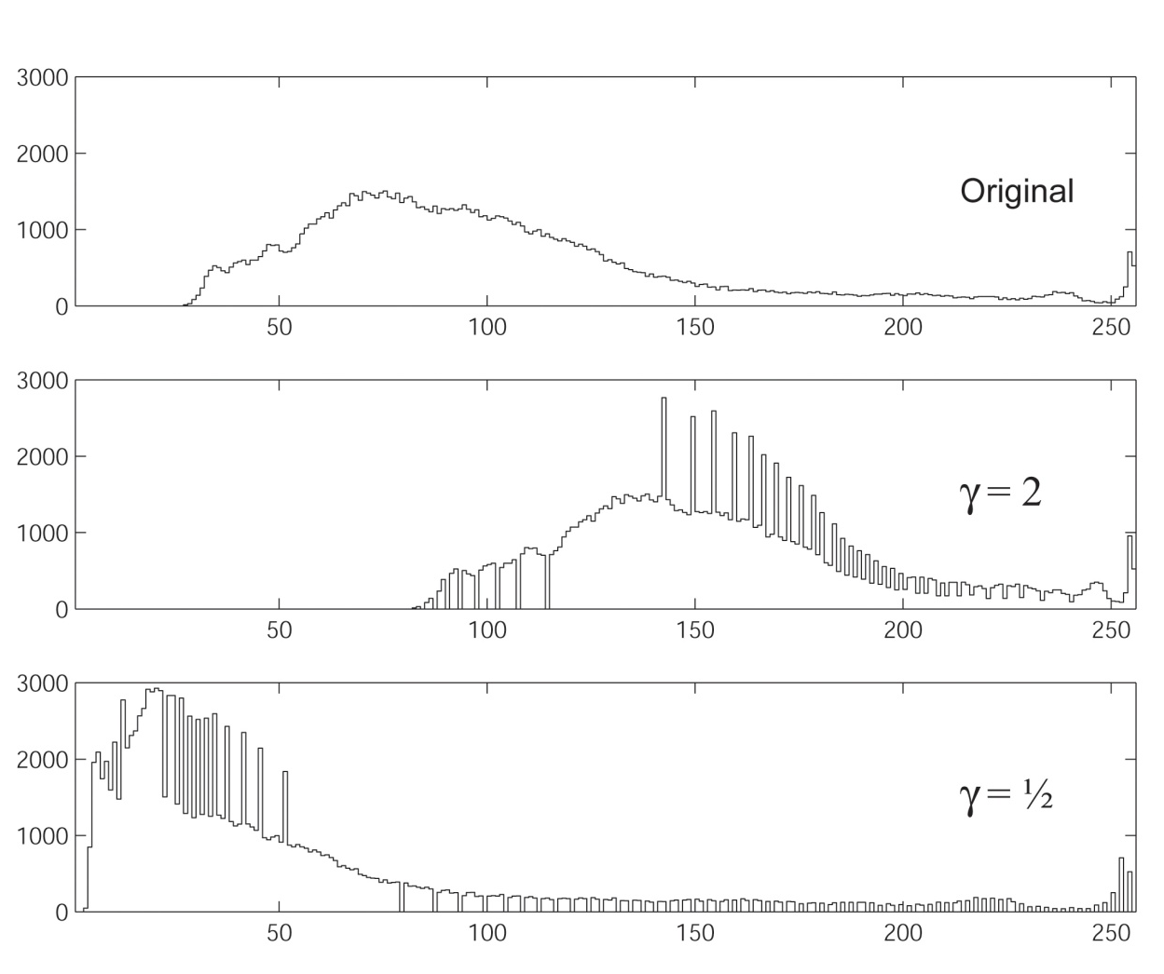
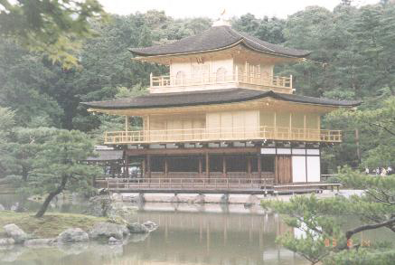
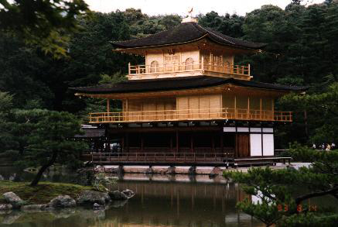
Gamma Correction: Effect on Histogram

Slide 37
Distribusi Kumulatif
Distribusi kumulatif C(x) adalah nilai total histogram dari tingkat keabuan=0 sampai dengan tingkat keabuan=x, dan didefinisikan dengan:
Distribusi kumulatif ini dapat digunakan untuk menunjukkan perkembangan dari setiap step derajat keabuan.
Pada distribusi kumulatif, gambar dikatakan baik bila mempunyai distribusi kumulatif yang pergerakannya hampir sama pada semua derajat keabuan.

Slide 38
Distribusi Kumulatif
Perubahan yang tajam

Slide 39
Distribusi Kumulatif
Gambar-gambar hasil photo mempunyai perubahan yang tidak terlalu tajam dan biasanya tidak lebih dari satu. Hal ini menunjukkan tingkat gradiasi yang halus pada gambar hasil photo.
Gambar-gambar kartun mempunya banyak perubahan yang tajam, hal ini menunjukkan tingkat gradiasi pada gambar kartun rendah (kasar).

Slide 40
Histogram Equalization
Histogram Equalization adalah suatu proses untuk meratakan histogram agar derajat keabuan dari yang paling rendah (0) sampai dengan yang paling tinggi (255) mempunyai kemunculan yang rata.
Dengan histogram equalization hasil gambar yang memiliki histogram yang tidak merata atau distribusi kumulatif yang banyak loncatan gradiasinya akan menjadi gambar yang lebih jelas karena derajat keabuannya tidak dominan gelap atau dominan terang.
Proses histogram equalization ini menggunakan distribusi kumulatif, karena dalam proses ini dilkakukan perataan gradien dari distribusi kumulatifnya.

Slide 41
Formulasi Histogram Equalization
Histogram Equalization dari suatu distribusi kumulatif C adalah:
C_{w} adalah nilai distribusi kumulatif pada derajat keabuan w
t adalah nilai threshold derajat keabuan= 2⁸ atau 256
n_{x} dan n_{y} adalah ukuran gambar.

Slide 42
Perhitungan Histogram Equalization
Perhatikan histogram berikut:
Distribusi Kumulatifnya
2 4 3 1 3 6 4 3 1 0 3 2
2 6 9 10 13 19 23 26 27 27 30 32

Slide 43
Perhitungan Histogram Equalization
Distribusi Kumulatif:
2 6 9 10 13 19 23 26 27 27 30 32
w | Cw | w-baru
1 | 2 | (2*12)/ 32 1
2 | 6 | 2
3 | 9 | 3
4 | 10 | 4
5 | 13 | 5
6 | 19 | 7
7 | 23 | 9
8 | 26 | 10
9 | 27 | 10
10 | 27 | 10
11 | 30 | 11
12 | 32 | 12

Slide 44
Histogram Equalization Pada Gambar

Slide 45
Histogram Equalization Pada Gambar

Slide 46
Histogram Equalization Pada Gambar

Slide 47
Histogram Equalization
Histogram: diagram yang menunjukkan jumlah kemunculan grey level (0-255) pada suatu citra
Histogram processing:
Gambar gelap: histogram cenderung ke sebelah kiri
Gambar terang: histogram cenderung ke sebelah kanan
Gambar low contrast: histogram mengumpul di suatu tempat
Gambar high contrast: histogram merata di semua tempat
→ Histogram processing: mengubah bentuk histogram
agar pemetaan gray level pada citra juga berubah

Slide 48
Histogram Equalization in all grey level and all area (1)
Ide: mengubah pemetaan greylevel agar sebarannya (kontrasnya) lebih menyebar pada kisaran 0-255
Sifat:
Grey level yang sering muncul lebih dijarangkan jaraknya dengan grey level sebelumnya
Grey level yang jarang muncul bisa lebih dirapatkan jaraknya dengan grey level sebelumnya
Histogram baru pasti mencapai nilai maksimal keabuan (contoh: 255)

Slide 49
Histogram Equalization in all grey level and all area (2)
mengubah pemetaan grey level pada citra, dengan rumus:

Slide 50
Histogram Equalization in all grey level and all area (3)
Citra awal:
3 5 5 5 4
5 4 5 4 4
5 3 4 4 4
4 5 6 6 3
Citra Akhir:
1 9 9 9 5
9 5 9 5 5
9 1 5 5 5
5 9 10 10 1
Contoh : citra dengan derajat keabuan hanya berkisar 0-10
Derajat Keabuan
Kemunculan Kunmulatif
Probabilitas Kemunculan
Sk
SK * 10
Derajat keabuan baru
0 | 1 | 2 | 3 | 4 | 5 | 6 | 7 | 8 | 9 | 10
0 | 0 | 0 | 3 | 8 | 7 | 2 | 0 | 0 | 0 | 0
0 | 0 | 0 | 3 | 11 | 18 | 20 | 20 | 20 | 20 | 20
(0*10)/20 | (0*10)/20 | (0*10)/20 | (3*10)/20 | (11*10)/20 | (18*10)/20 | (20*10)/20 | (20*10)/20 | (20*10)/20 | (20*10)/20 | (20*10)/20
0 | 0 | 0 | 0.15 | 0.40 | 0.35 | 0.1 | 0 | 0 | 0 | 0
0 | 0 | 0 | 0.15 | 0.55 | 0.90 | 1 | 1 | 1 | 1 | 1
0 | 0 | 0 | 1.5 | 5.5 | 9 | 10 | 10 | 10 | 10 | 10
0 | 0 | 0 | 1 | 5 | 9 | 10 | 10 | 10 | 10 | 10

Slide 51
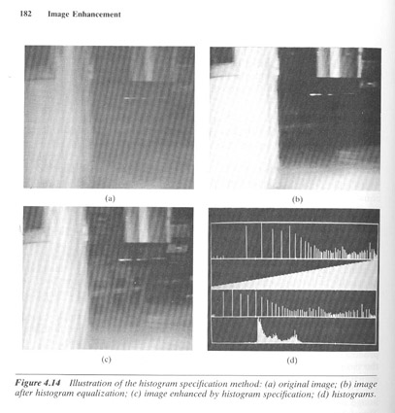
Histogram Equalization specific grey level (hist. specification)
Histogram equalization tidak dilakukan pada seluruh bagian dari histrogram tapi hanya pada bagian tertentu saja

Slide 52
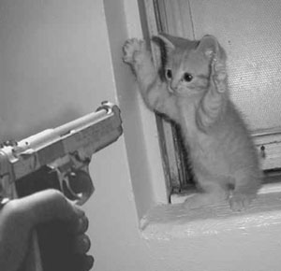
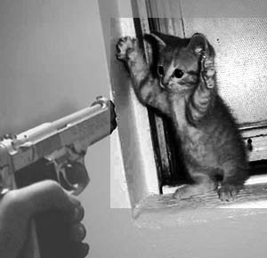
Histogram Equalization specific area (local enhancement)
Histogram equalization hanya dilakukan pada bagian tertentu dari citra

Slide 53
The Probability Density Function of an Image
pdf
[lower case]
This is the probability that an arbitrary pixel from I_{k} has value g.

Slide 54
The Probability Density Function of an Image
p_{band}(g+1) is the fraction of pixels in (a specific band of) an image that have intensity value g.
p_{band}(g+1) is the probability that a pixel randomly selected from the given band has intensity value g.
Whereas the sum of the histogram h_{band}(g+1) over all g from 1 to 256 is equal to the number of pixels in the image, the sum of p_{band}(g+1) over all g is 1.
p_{band} is the normalized histogram of the band.

Slide 55
The Probability Distribution Function of an Image
Let q = [q₁ q₂ q₃] = I(r,c) be the value of a randomly selected pixel from I. Let g be a specific graylevel. The probability that q_{k} ≤ g is given by
PDF
[upper case]
where h_{Ik}(γ +1) is the histogram of the kth band of I.
This is the probability that any given pixel from I_{k} has value less than or equal to g.

Slide 56
The Probability Distribution Function of an Image
Let q = [q₁ q₂ q₃] = I(r,c) be the value of a randomly selected pixel from I. Let g be a specific graylevel. The probability that q_{k} ≤ g is given by
Also called CDF for “Cumulative Distribution Function”.
where h_{Ik}(γ +1) is the histogram of the kth band of I.
This is the probability that any given pixel from I_{k} has value less than or equal to g.

Slide 57
The Probability Distribution Function of an Image
A.k.a. Cumulative Distribution Function.
P_{band}(g+1) is the fraction of pixels in (a specific band of) an image that have intensity values less than or equal to g.
P_{band}(g+1) is the probability that a pixel randomly selected from the given band has an intensity value less than or equal to g.
P_{band}(g+1) is the cumulative (or running) sum of p_{band}(g+1) from 0 through g inclusive.
P_{band}(1) = p_{band}(1) and P_{band}(256) = 1; P_{band}(g+1) is nondecreasing.
Note: the Probability Distribution Function (PDF, capital letters) and the Cumulative Distribution Function (CDF) are exactly the same things. Both PDF and CDF will refer to it. However, pdf (small letters) is the density function.

Slide 58
Point Processes: Histogram Equalization
Task: remap image I so that its histogram is as close to constant as possible
be the cumulative (probability) distribution function of I.
Then J has, as closely as possible, the correct histogram if
all bands
processed
similarly
The CDF itself is used as the LUT.

Slide 59
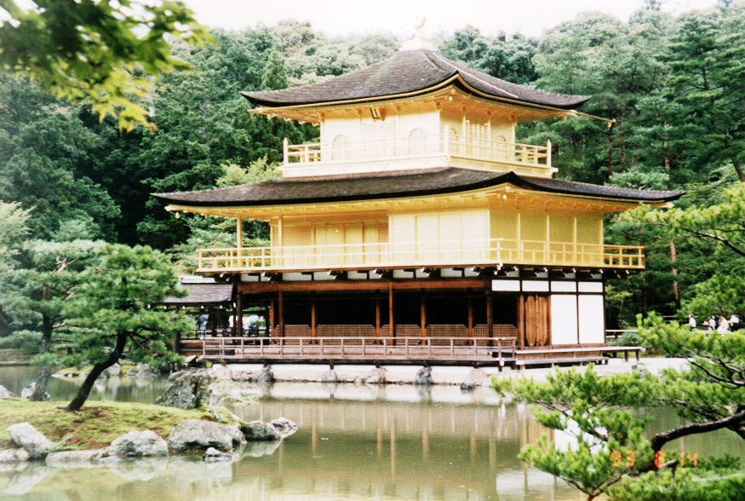
Point Processes: Histogram Equalization
Luminosity
before
after

Slide 60
Histogram EQ
The CDF (cummulative distribution) is the LUT for remapping.
pdf
CDF

Slide 61
Histogram EQ
The CDF (cummulative distribution) is the LUT for remapping.
pdf
LUT

Slide 62
Histogram EQ
The CDF (cummulative distribution) is the LUT for remapping.
pdf
LUT

Slide 63
Histogram EQ

Slide 64
Point Processes: Histogram Equalization
Task: remap image I with min = m_{I} and max = M_{I} so that its histogram is as close to constant as possible and has min = m_{J} and max = M_{J} .
be the cumulative (probability) distribution function of I.
Then J has, as closely as possible, the correct histogram if
Using intensity extrema

Slide 65
Point Processes: Histogram Matching
Task: remap image I so that it has, as closely as possible, the same histogram as image J.
Because the images are digital it is not, in general, possible to make h_{I} ≡ h_{J} . Therefore, p_{I} ≡ p_{J} .
Q: How, then, can the matching be done?
A: By matching percentiles.

Slide 66
Matching Percentiles
… assuming a 1-band image or a single band of a color image.
Recall:
The CDF of image I is such that 0 ≤ P_{I} ( g_{I} ) ≤ 1.
P_{I} ( g_{I} +1) = c means that c is the fraction of pixels in I that have a value less than or equal to g_{I} .
100c is the percentile of pixels in I that are less than or equal to g_{I} .
To match percentiles, replace all occurrences of value g_{I} in image I with the value, g_{J}, from image J whose percentile in J most closely matches the percentile of g_{I} in image I.

Slide 67
Matching Percentiles
… assuming a 1-band image or a single band of a color image.
So, to create an image, K, from image I such that K has nearly the same CDF as image J do the following:
Example:
I(r,c) = 5
P_{I} (5) = 0.65
P_{J} (9) = 0.56
P_{J} (10) = 0.67
K(r,c) = 10
If I(r,c) = g_{I} then let K(r,c) = g_{J} where g_{J} is such that
P_{I} (g_{I}) > P_{J} (g_{J} -1) AND P_{I} (g_{I}) ≤ P_{J} (g_{J}).
P_{I} ( g_{I} )
P_{J} ( g_{J} )
g_{I}
g_{J}

Slide 68
Histogram Matching Algorithm
… assuming a 1-band image or a single band of a color image.
[R,C] = size(I);
K = zeros(R,C);
g_{J} = m_{J;}
This directly matches image I to image J.
for g_{I} = m_{I} to M_{I}
while
end
Better to use a LUT. See slide 54.
end

Slide 69
Example: Histogram Matching
Image pdf
Image with
16 intensity
values
g

Slide 70
Image CDF
Example: Histogram Matching
CDF_{I}(g)
*
g
*a.k.a Cumulative Distribution Function, CDF_{I}.

Slide 71
Example: Histogram Matching
Target pdf
Target with
16 intensity
values
g

Slide 72
Target CDF
Example: Histogram Matching
CDF_{I}(g)
*
g
*a.k.a Cumulative Distribution Function, CDF_{J}.

Slide 73
Histogram Matching with a Lookup Table
The algorithm on slide 50 matches one image to another directly. Often it is faster or more versatile to use a lookup table (LUT). Rather than remapping each pixel in the image separately, one can create a table that indicates to which target value each input value should be mapped. Then
K = LUT[I+1]
In Matlab if the LUT is a 256 × 1 matrix with values from 0 to 255 and if image I is of type uint8, it can be remapped with the following code:
K = uint8(LUT(double(I)+1));

Slide 74
LUT Creation
Image CDF
Target CDF
LUT
10

Slide 75
Look Up Table for Histogram Matching
This creates a look-up table which can then be used to remap the image.
LUT = zeros(256,1);
g_{J} = 0;
for g_{I} = 0 to 255
while
end
end

Slide 76
Input & Target CDFs, LUT and Resultant CDF
P_{I} ( g )
Input
P_{J} ( g )
Target
g
g
LUT
Result
LUT ( g )
P_{K} ( g )
g
g

Slide 77
Example: Histogram Matching
original
target
remapped

Slide 78
Probability Density Functions of a Color Image
red pdf
blue pdf
Atlas-Mercury
green pdf
luminosity pdf

Slide 79
Cumulative Distribution Functions (CDF)
red CDF
blue CDF
green CDF
luminosity CDF

Slide 80
Probability Density Functions of a Color Image
red pdf
blue pdf
TechnoTrousers
green pdf
luminosity pdf

Slide 81
Cumulative Distribution Functions (CDF)
red CDF
blue CDF
green CDF
luminosity CDF

Slide 82
Remap an Image to have the Lum. CDF of Another
original
target
luminosity remapped

Slide 83
CDFs and the LUT
Atlas-Mercury Luminosity CDF
TechnoTrousers Luminosity CDF
LUT (Luminosity) Atlas-Mercury to TechnoTrousers
Atlas-Mercury Remapped Luminosity CDF

Slide 84
Effects of Luminance Remapping on pdfs
Before
After

Slide 85
Effects of Luminance Remapping on CDFs
Before
After

Slide 86
Remap an Image to have the rgb CDF of Another
original
target
R, G, & B remapped

Slide 87
CDFs and the LUTs
Atlas-Mercury Red PDF
Atlas-Mercury Green PDF
Atlas-Mercury Blue PDF
TechnoTrousers Red PDF
TechnoTrousers Green PDF
TechnoTrousers Blue PDF
LUT (Red) Atlas-Mercury to TechnoTrousers
LUT (Green) Atlas-Mercury to TechnoTrousers
LUT (Blue) Atlas-Mercury to TechnoTrousers
Atlas-Mercury RGB Remapped Red PDF
Atlas-Mercury RGB Remapped Green PDF
Atlas-Mercury RGB Remapped Blue PDF

Slide 88
Effects of RGB Remapping on pdfs
Before
After

Slide 89
Effects of RGB Remapping on CDFs
Before
After

Slide 90
Remap an Image:
To Have Two of its Color pdfs Match the Third
original
G & B R
B & R G
R & G B

